Slide 1
Tender Briefing Session
Presented By: Name Surname
Notes:
Growth and Reinvent

Slide 2
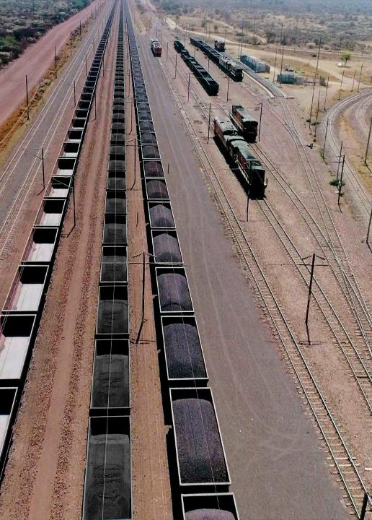
Contents
Title Or Theme Goes Here
01 | Introduction
02 | Project scope
03 | Technical Evaluation Criteria
04 | Q&A
2

Slide 3
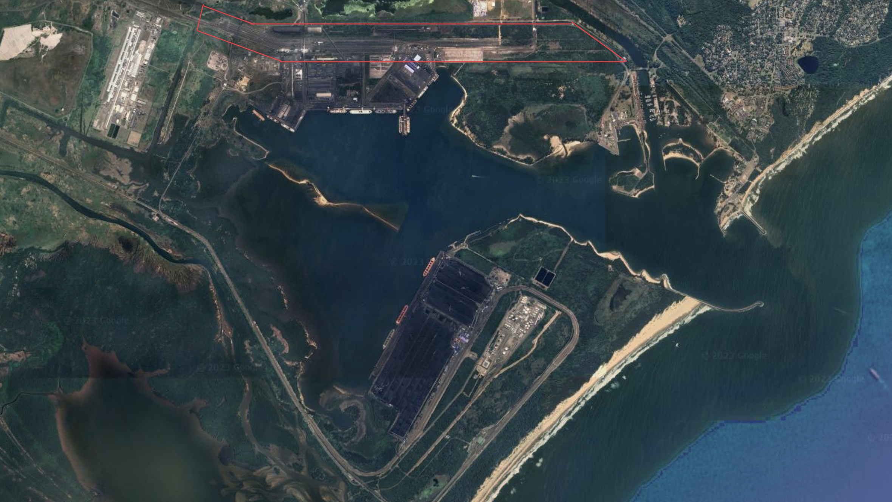

Slide 4
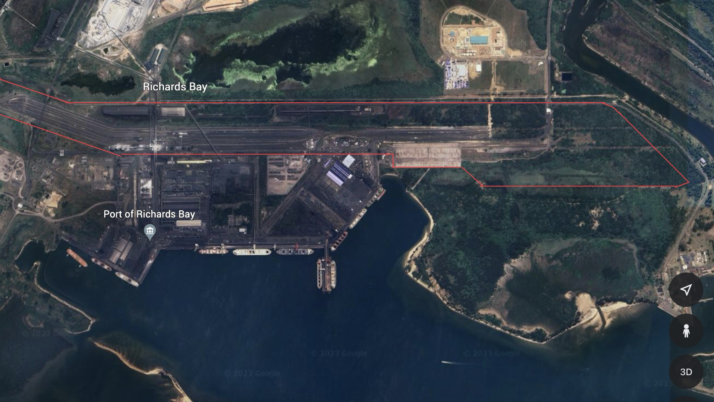
Background | Current challenges | Proposed solution
Commissioned: 19xx Design capacity: 40 CFR wagon | Congestions in the terminal Train must be spilt accommodate the available staging area Increases train turnaround times | Reconfiguration of Bayvue Rail Yard to accommodate 150 wagon trains with a phasing of 75 wagon trains;

Slide 5
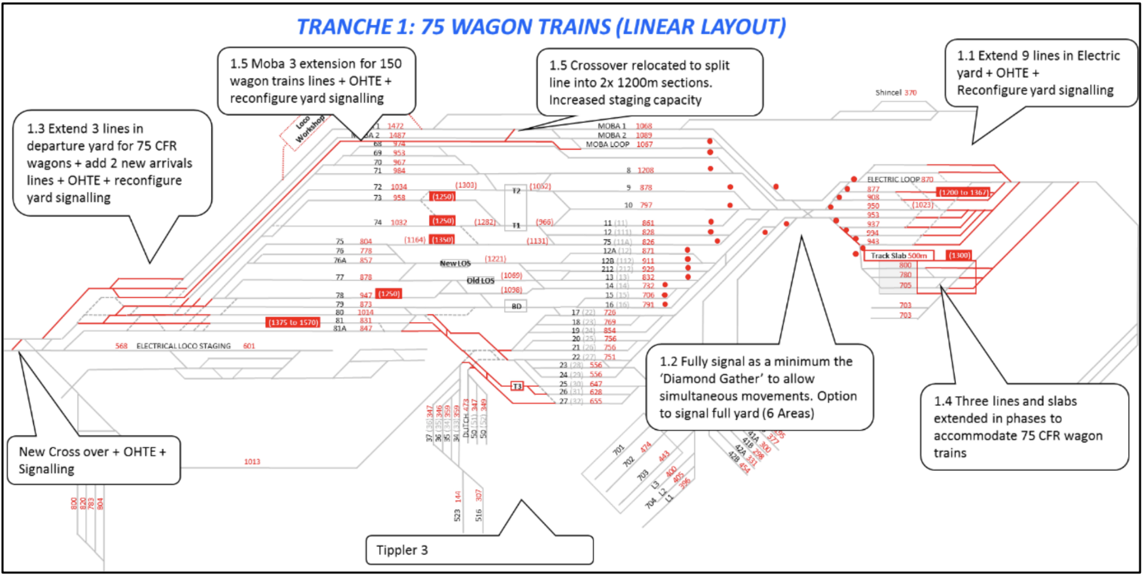
Project Scope Overview
Tranche 1: 75 wagon trains
Arrival/electric yards extensions – extend 9 lines in electric yard + OHTE + Reconfigure yard signalling
Yard Signaling – fully signal as a minimum the “diamond gather” to allow simulate one’s movements
Departure yard extension – extended 3lines in denatured yard for 75 CFR wagons = add 2 new arrival lines lines + OHTE + Reconfig yard signalling
Ferry chrome yard extension – 3 line lines extended and slab to accommodate 75 CFR wagons
Moba loop extension - Moba 3 extension for 150 wagon train lines + OHTE + reconfigure yard signalling + relocation of crossover to split lines in 2x 1200m sections to increase staging capacity.

Slide 6
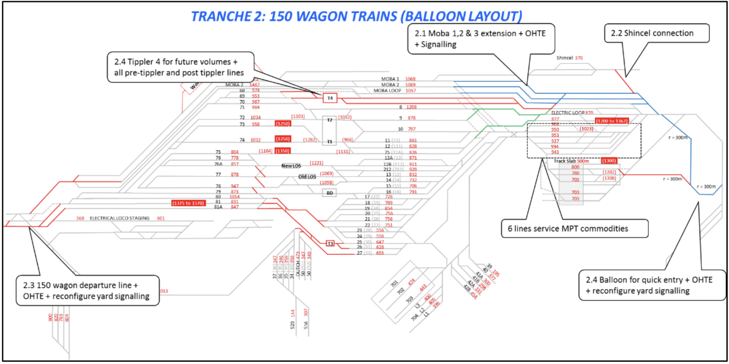
Project Scope Overview
Tranche 2: 150 wagon trains
Extension of Moba loop 1,2 & 3 – Moba 1,2,&3 extension + OHTE + signalling
Schincel connection – Connection to Schincel from East end of electric yard
150 wagon departure line – 150 wagon departures line + OHTE + reconfigure yard signaling
Balloon development lines – balloon for quick entry + OHTE + reconfigure yard signalling

Slide 7
Task Order 1
5 months
Task Order 2
10 months
Task Order 3
4 months
Task Order 4
18 months
Task Order 5
10 months
Task Order 1
5 months
Task Order 2
10 months
Task Order 3
4 months
Task Order 4
18 months
Task Order 5
10 months

Slide 8
Description: Concept design
Scope:
The Consultant shall simulate, model and verify for various recommended options, while taking into account the required optimisation of capital, to accommodate the Employer’s phasing option requirements, as well as producing the proposed designs, schedules, cost estimates, constructability sequencing, risks and assumptions associated with the new phasing methodology.
Deliverables:
Geotechnical investigations
Surveys
Engineering model and operating philosophy
Traffic studies
Work break down structure
Early works
Preliminary cost estimates
Project schedule
Stakeholder engagement
Business case inputs
3D rendered drawing
Operating philosophy
Timelines: 5 months
Task Order 01
Task Order 02
Task Order 03
Task Order 04
Task Order 05

Slide 9
Description: Detail design for 75 wagon trains
Scope:
The consultant shall commence and complete the detailed engineering design work to 100% AFC level details which includes development of engineering design works to a level that is. For the purpose to support procurement, construction and project controls.
Deliverables:
Details design drawings
Works information
Final cost estimates
Construction schedule
Execution plan
Health and safety relevant notifications and compliance
Execution Business case
Prepared bid documents for constructions
Environmental authorisations and permits
gate review process
Timelines: 10 Months
Task Order 01
Task Order 02
Task Order 03
Task Order 04
Task Order 05

Slide 10
Description: Procurement Support
Scope:
The Consultant shall provide procurement support to the Employer during the procurement stages.
Deliverables:
Technical queries
Tender clarifications
Site visits
Technical evaluations
Timeline: 4 months
Task Order 01
Task Order 02
Task Order 03
Task Order 04
Task Order 05

Slide 11
Description: Engineering and construction management
Scope:
The Consultant shall undertake the engineering management and resident engineer function for the project on behalf of the Employer. The Consultant shall undertake the execution and construction management for the project on behalf of the employer. At the end of the construction the consultant shall commission all TNPA infrastructure deliverable by the project.
Deliverables:
Technical support functions
Project and contracts management functions
Commission the TNPA infrastructure
Timelines: 18 months
Task Order 01
Task Order 02
Task Order 03
Task Order 04
Task Order 05

Slide 12
Description: Detail design for 150 wagons train
Scope:
The consultant shall undertake take both concept and detailed design to accommodate the 150wagons trains for future implementation up to and including all gate reviews
Deliverables:
Concept design for 150 wagons trains
Details design drawings
Works information final cost estimates
Construction schedule
Execution plan
Health and safety relevant notifications and compliance
Execution Business case
Prepared bid documents for constructions
Environmental authorisations and permits
gate review process
Timelines: 10 months
Task Order 01
Task Order 02
Task Order 03
Task Order 04
Task Order 05

Slide 13
EVALUATION CRITERIA
Sub-heading text here

Slide 14
CRITERIA | WEIGHT
T2.2-02: MANAGEMENT & CVs OF KEY PERSONS | 55
T2.2-03: APPROACH PAPER | 25
T2.2-04: COMPANY EXPERIENCE | 15
T2.2-05: PROGRAMME | 5
TOTAL | 100
MINIMUM OF 70 POINTS MUST BE OBTAINED ON FUNCTIONALITY ORDER TO PROCEED TO THE NEXT STAGE OF EVALUATION

Slide 15
T2.2-02
MANAGEMENT & CVs OF KEY PERSONS
55 POINTS
Evaluation Criteria: Qualifications, Training and skills, Professional Registrations, and years of experience
Engineering Manager
Senior Design Engineer
Civil Engineer
Electrical Engineer
Electrical Engineer
Senior Project Manager
Senior Construction Manager
Environmental Manager
Safety Agent
Project Controls Manager
Quantity surveyor
Quality officer
Contracts admin
T2.2-03
APPROACH PAPER
20 POINTS
T2.2-04
COMPANY EXPERIENCE
15 POINTS
T2.2-05
PROGRAMME
10 POINTS

Slide 16
T2.2-02
MANAGEMENT & CVs OF KEY PERSONS
55 POINTS
Evaluation Criteria:
Outline of proposed approach
Feasibility design development approach
Design Reviewing process
Detailed list of other resources, professional skills and utilisation including a resource matrix
Management tools and system
Works Information (design philosophy)
Detailed method statement, technical approach and Task Order 1 and 2 sequencing in terms of the scope
T2.2-03
APPROACH PAPER
20 POINTS
T2.2-04
COMPANY EXPERIENCE
15 POINTS
T2.2-05
PROGRAMME
10 POINTS

Slide 17
T2.2-02
MANAGEMENT & CVs OF KEY PERSONS
55 POINTS
Evaluation criteria:
Similar projects: Minimum 2 similar type projects
Number of references: Minimum 2 references
T2.2-03
APPROACH PAPER
20 POINTS
T2.2-04
COMPANY EXPERIENCE
15 POINTS
T2.2-05
PROGRAMME
10 POINTS

Slide 18
T2.2-02
MANAGEMENT & CVs OF KEY PERSONS
55 POINTS
Evaluation criteria:
Ability to execute the works in terms of the Employer’s requirements within the required timeframe indicating, in a logical sequence, the order and timing of Task Order 1 and 2 that will take place in order to provide the works in a logical sequence.
The main activities for the assignment, their content and duration.
Phasing and interrelations
Milestones including interim approvals by the Project Manager and/or the Employer
Delivery dates of all key deliverables
Minimum 15 months for Task Order 1 and 2
T2.2-03
APPROACH PAPER
20 POINTS
T2.2-04
COMPANY EXPERIENCE
15 POINTS
T2.2-05
PROGRAMME
10 POINTS

Slide 19
Thank you

